Slide 1
C# is awesome!
Sanjar Akhmedov

Slide 2




About me
Sanjar Akhmedov
Software Engineer
Silk Road Professionals
3 years of experience
/Akhmedov_Sanjar
/Akhmedov_Sanjar
/SanjarSoftdev

Slide 3
Params Collections
New LINQ methods
The field keyword
Agenda
New Lock Object
Partial properties
Overload resolution priority

Slide 4
Params Collections
Starting with C# 13, the params modifier supports any collection type that implements IEnumerable<T>, not just arrays

Slide 5
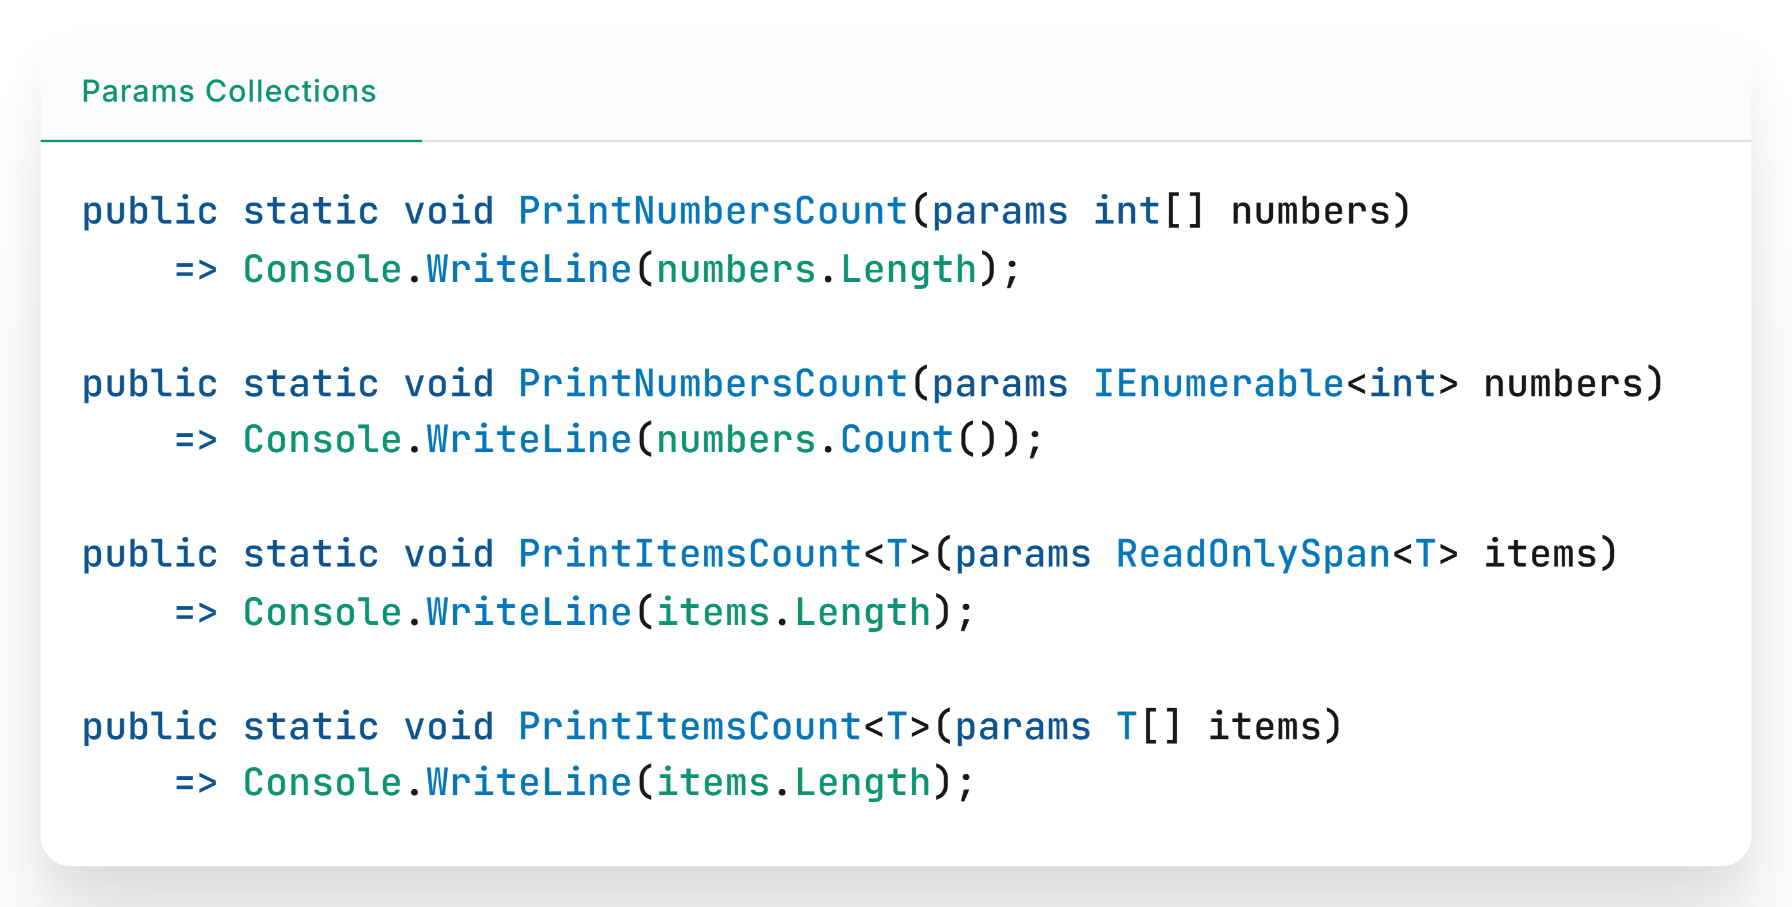

Slide 6
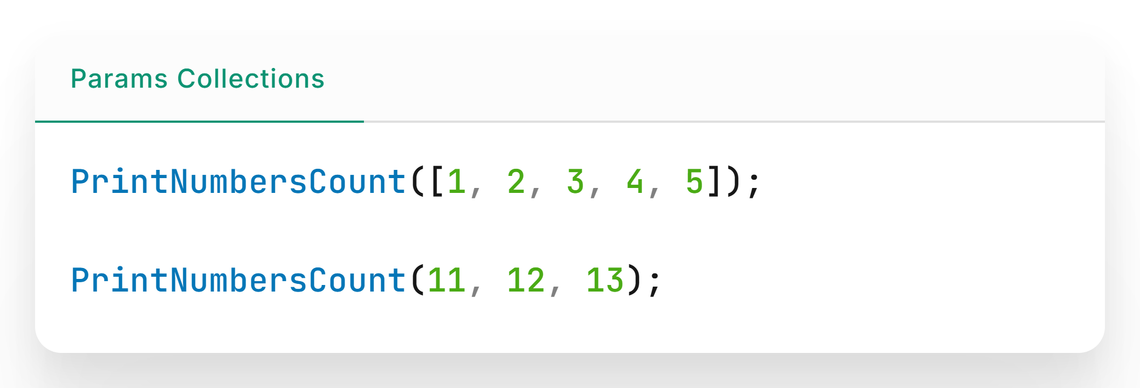
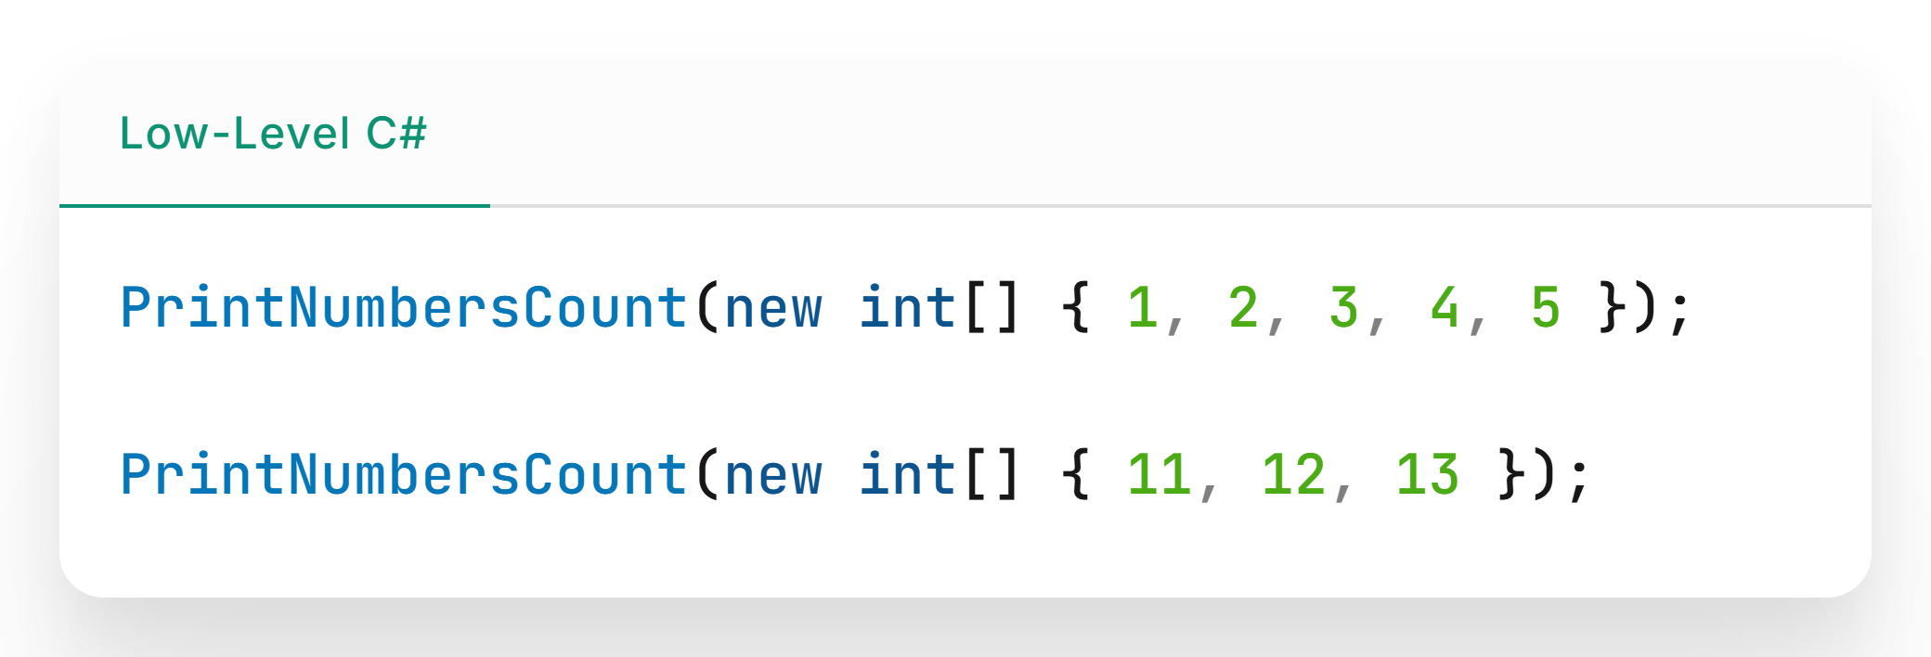

Slide 7
New LINQ methods
Introducing new methods: CountBy, AggregateBy, and Index. These methods boost performance and simplify common data tasks.

Slide 8
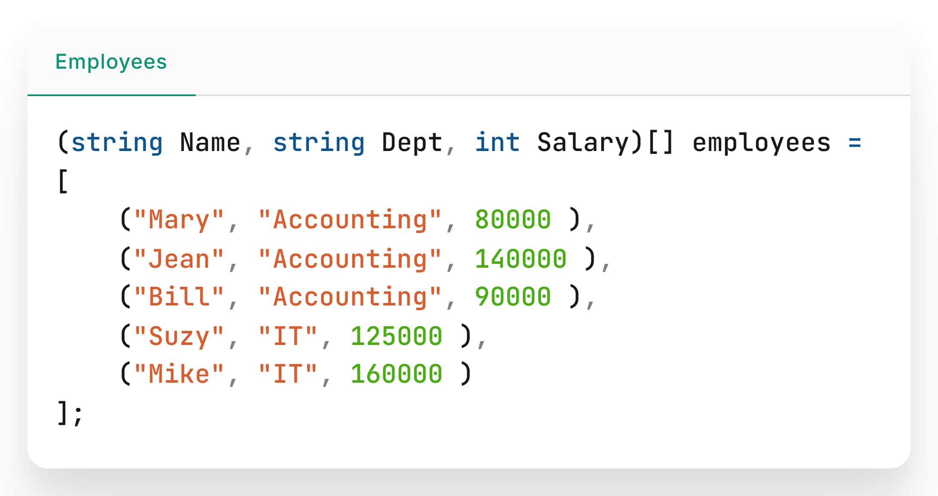

Slide 9
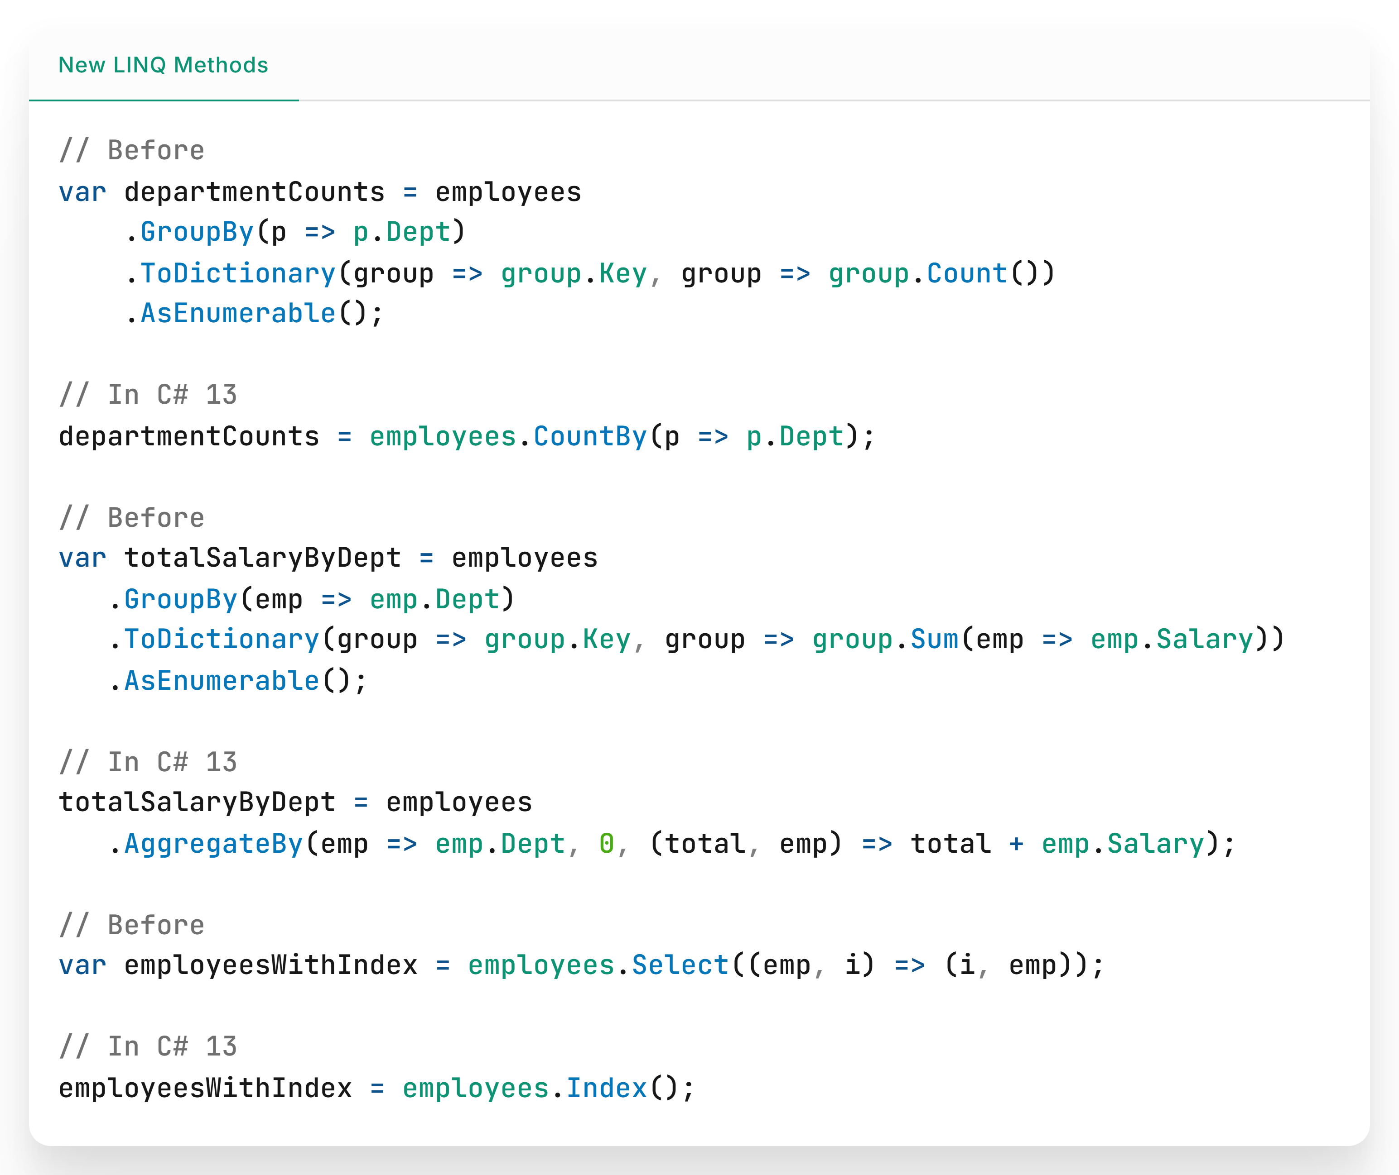

Slide 10
The field keyword
C# 13 introduces the field keyword, which lets you access a property's backing field directly.

Slide 11
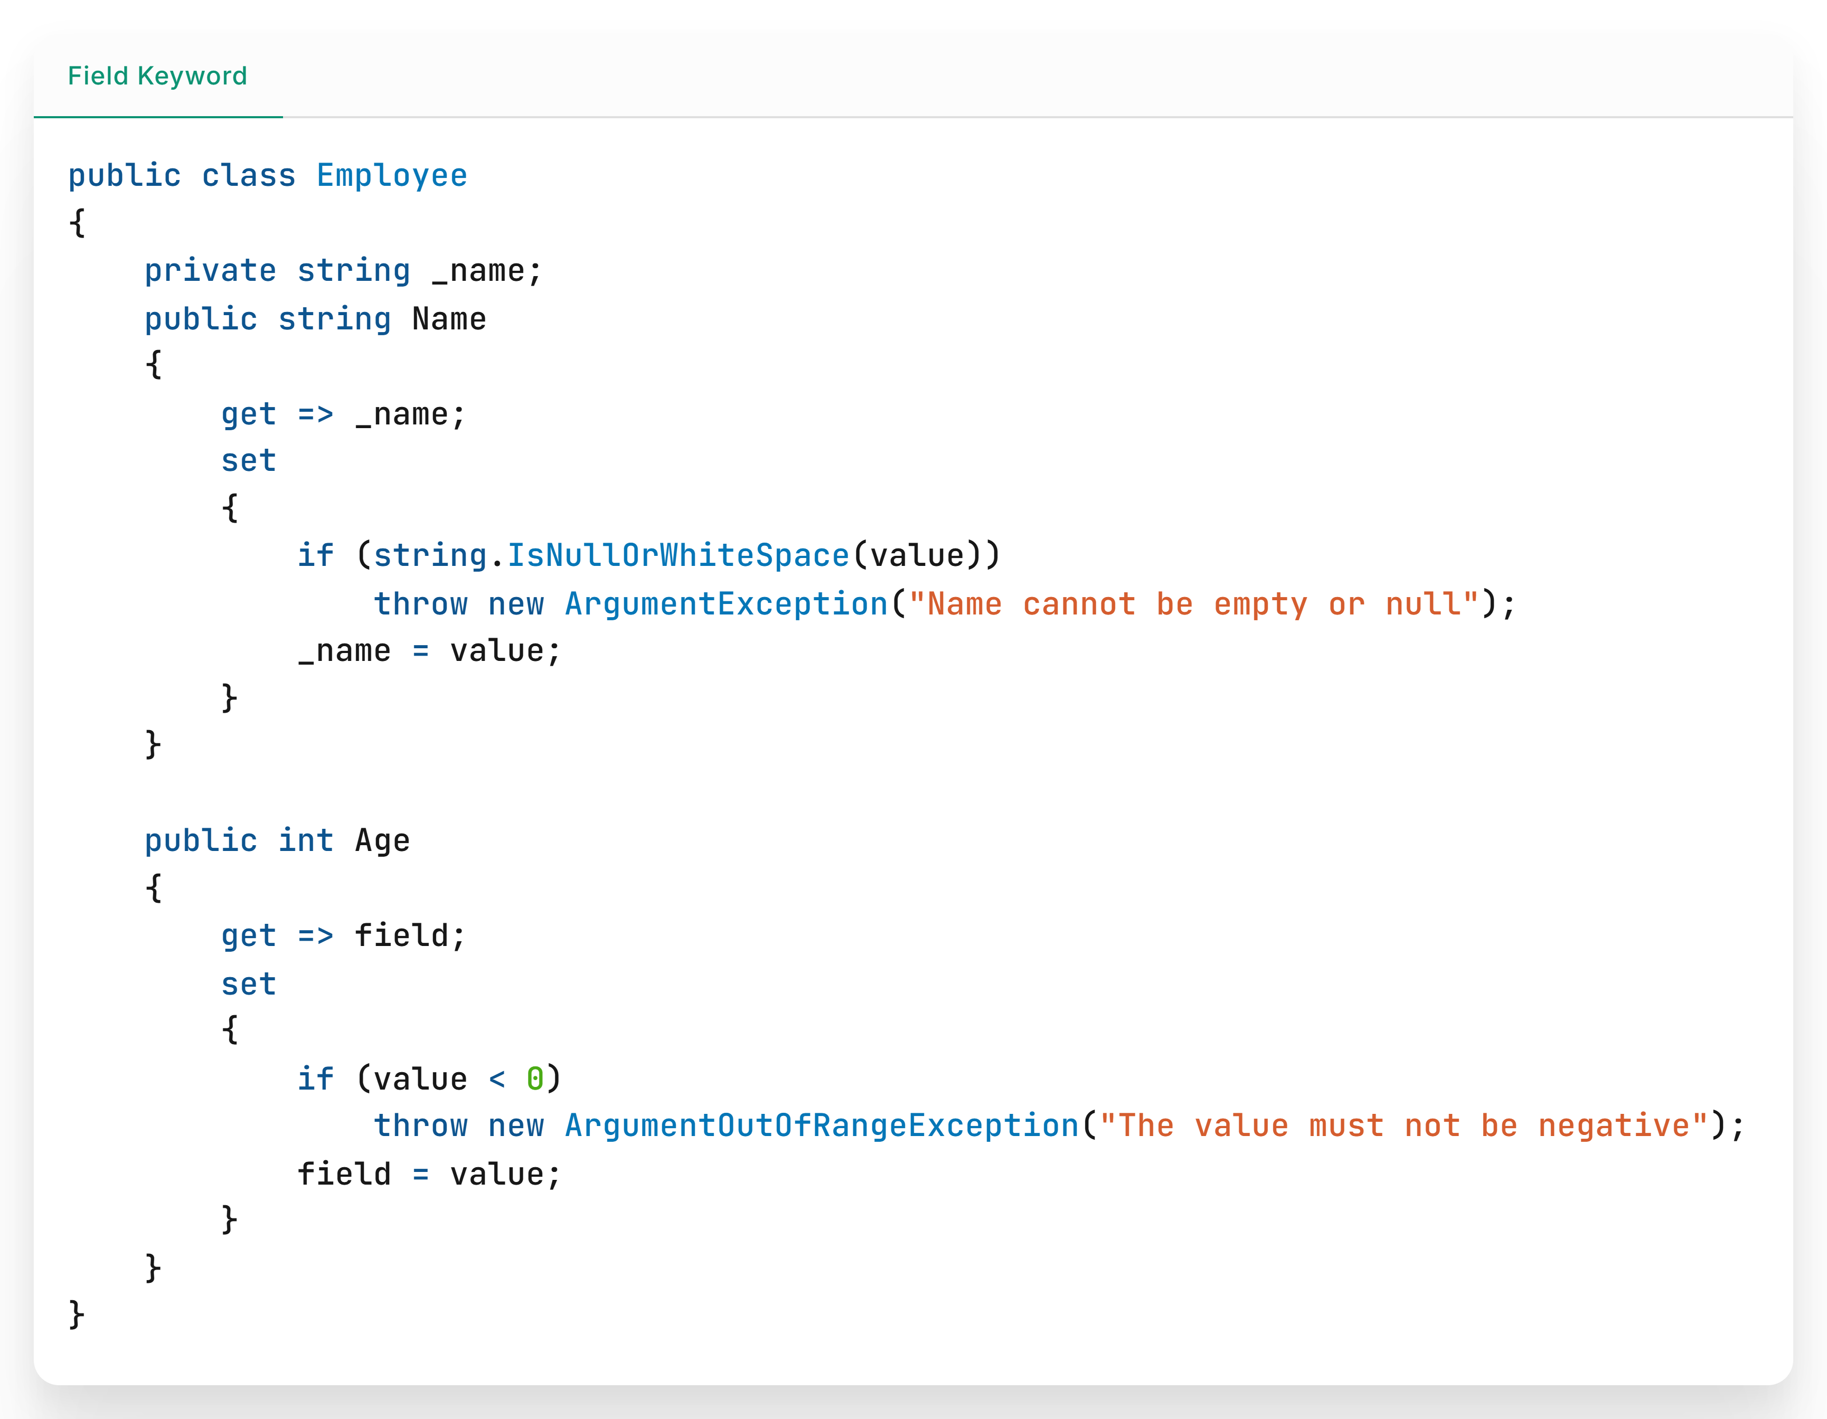

Slide 12
New Lock Object
The new System.Threading.Lock in C# 13 makes thread synchronization easier and safer, helping your code run smoothly and reliably in multithreaded environments.

Slide 13
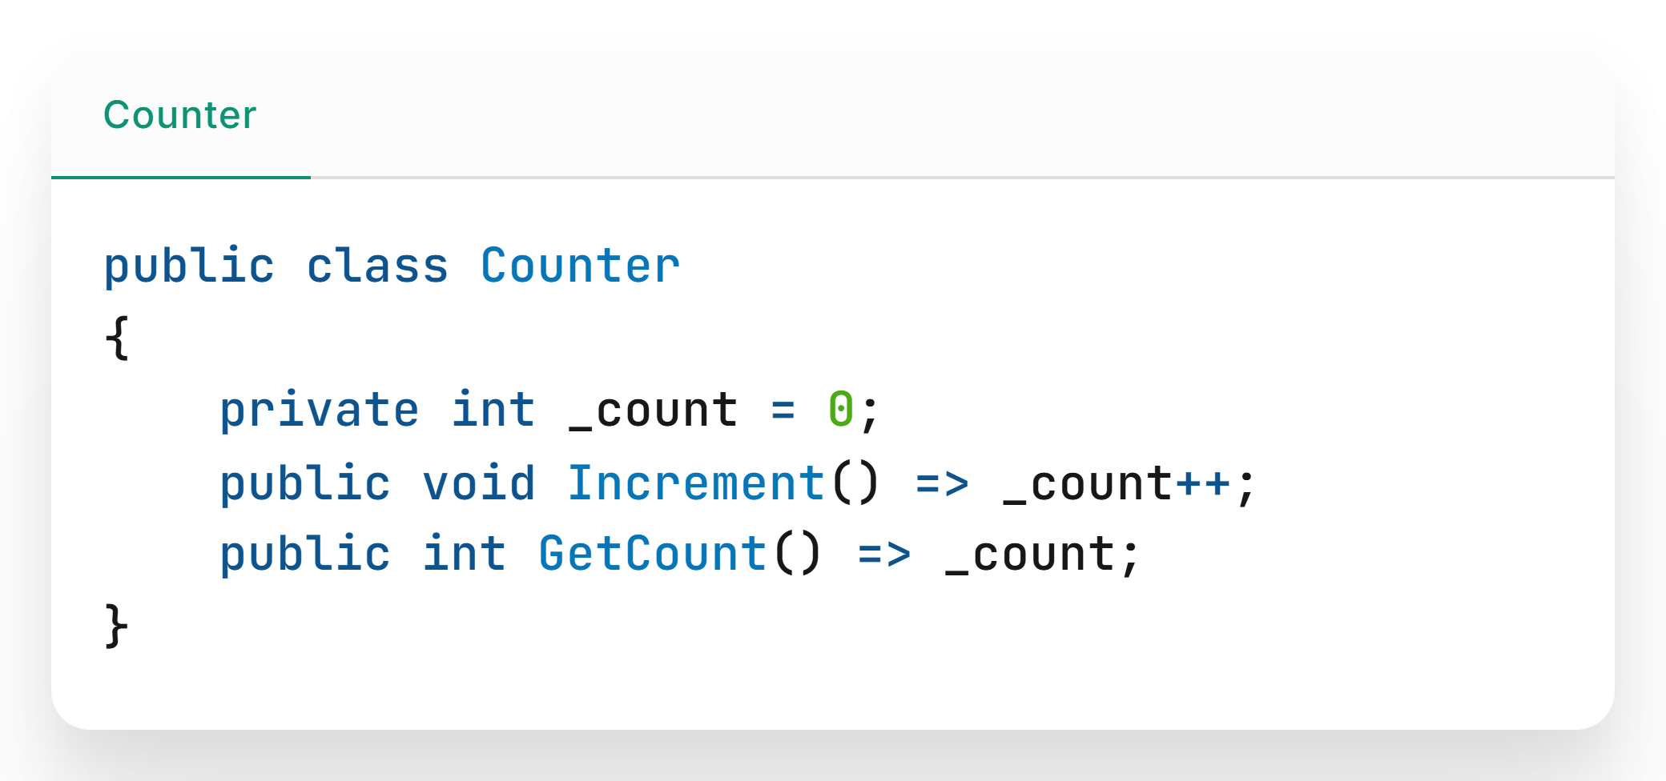
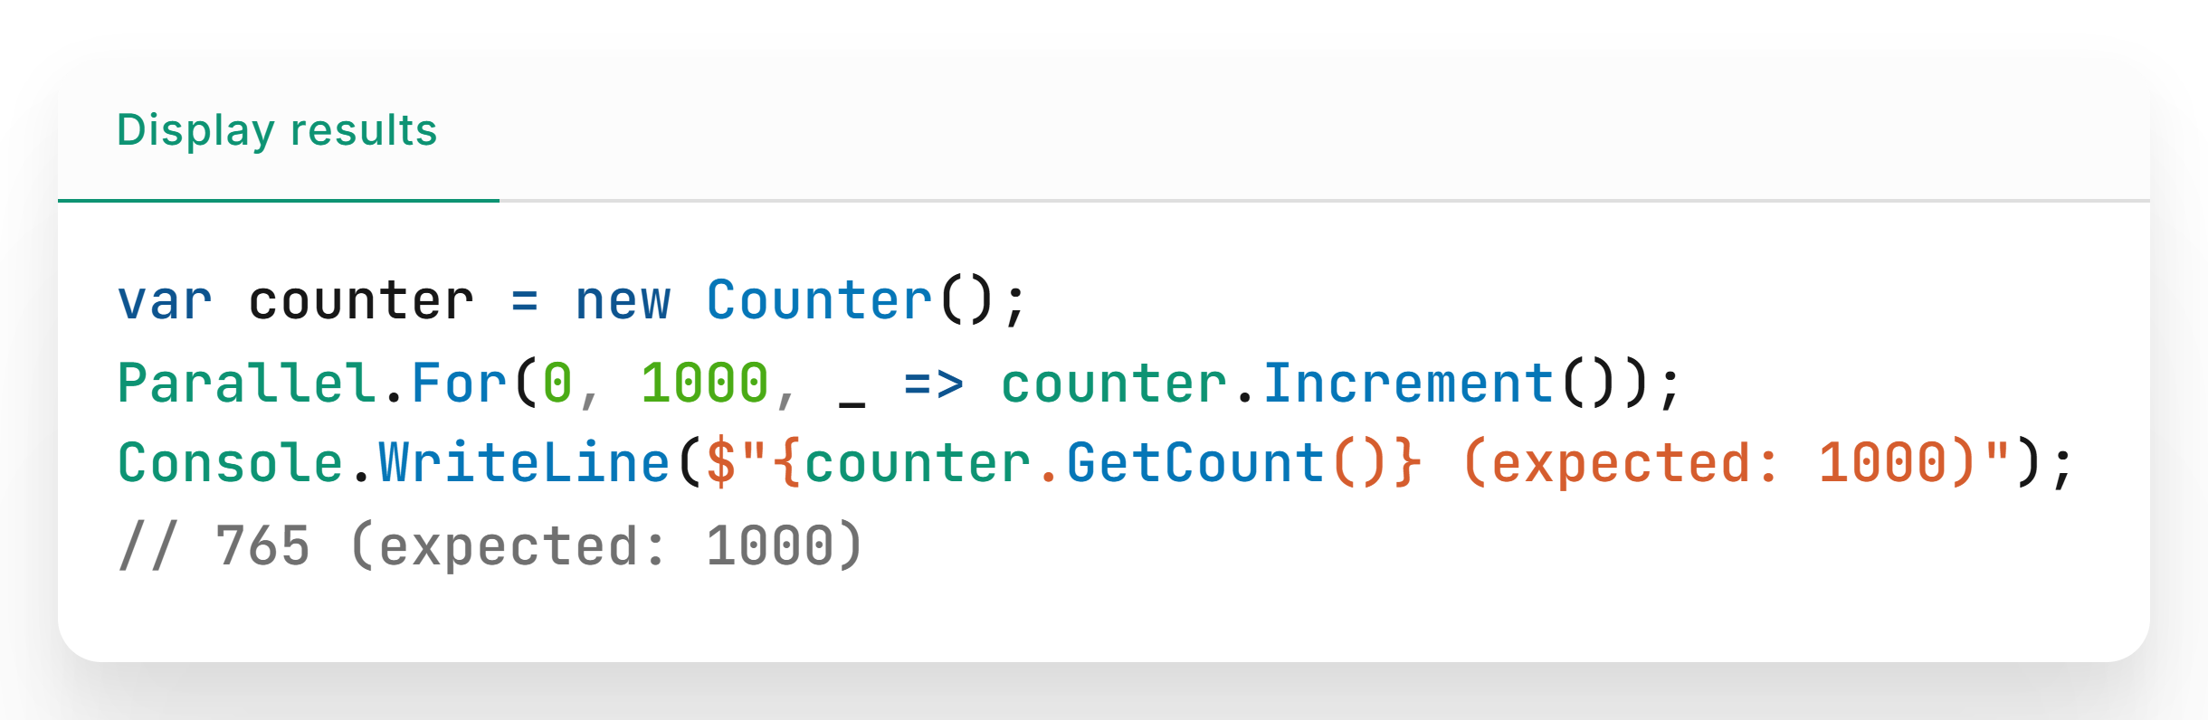

Slide 14
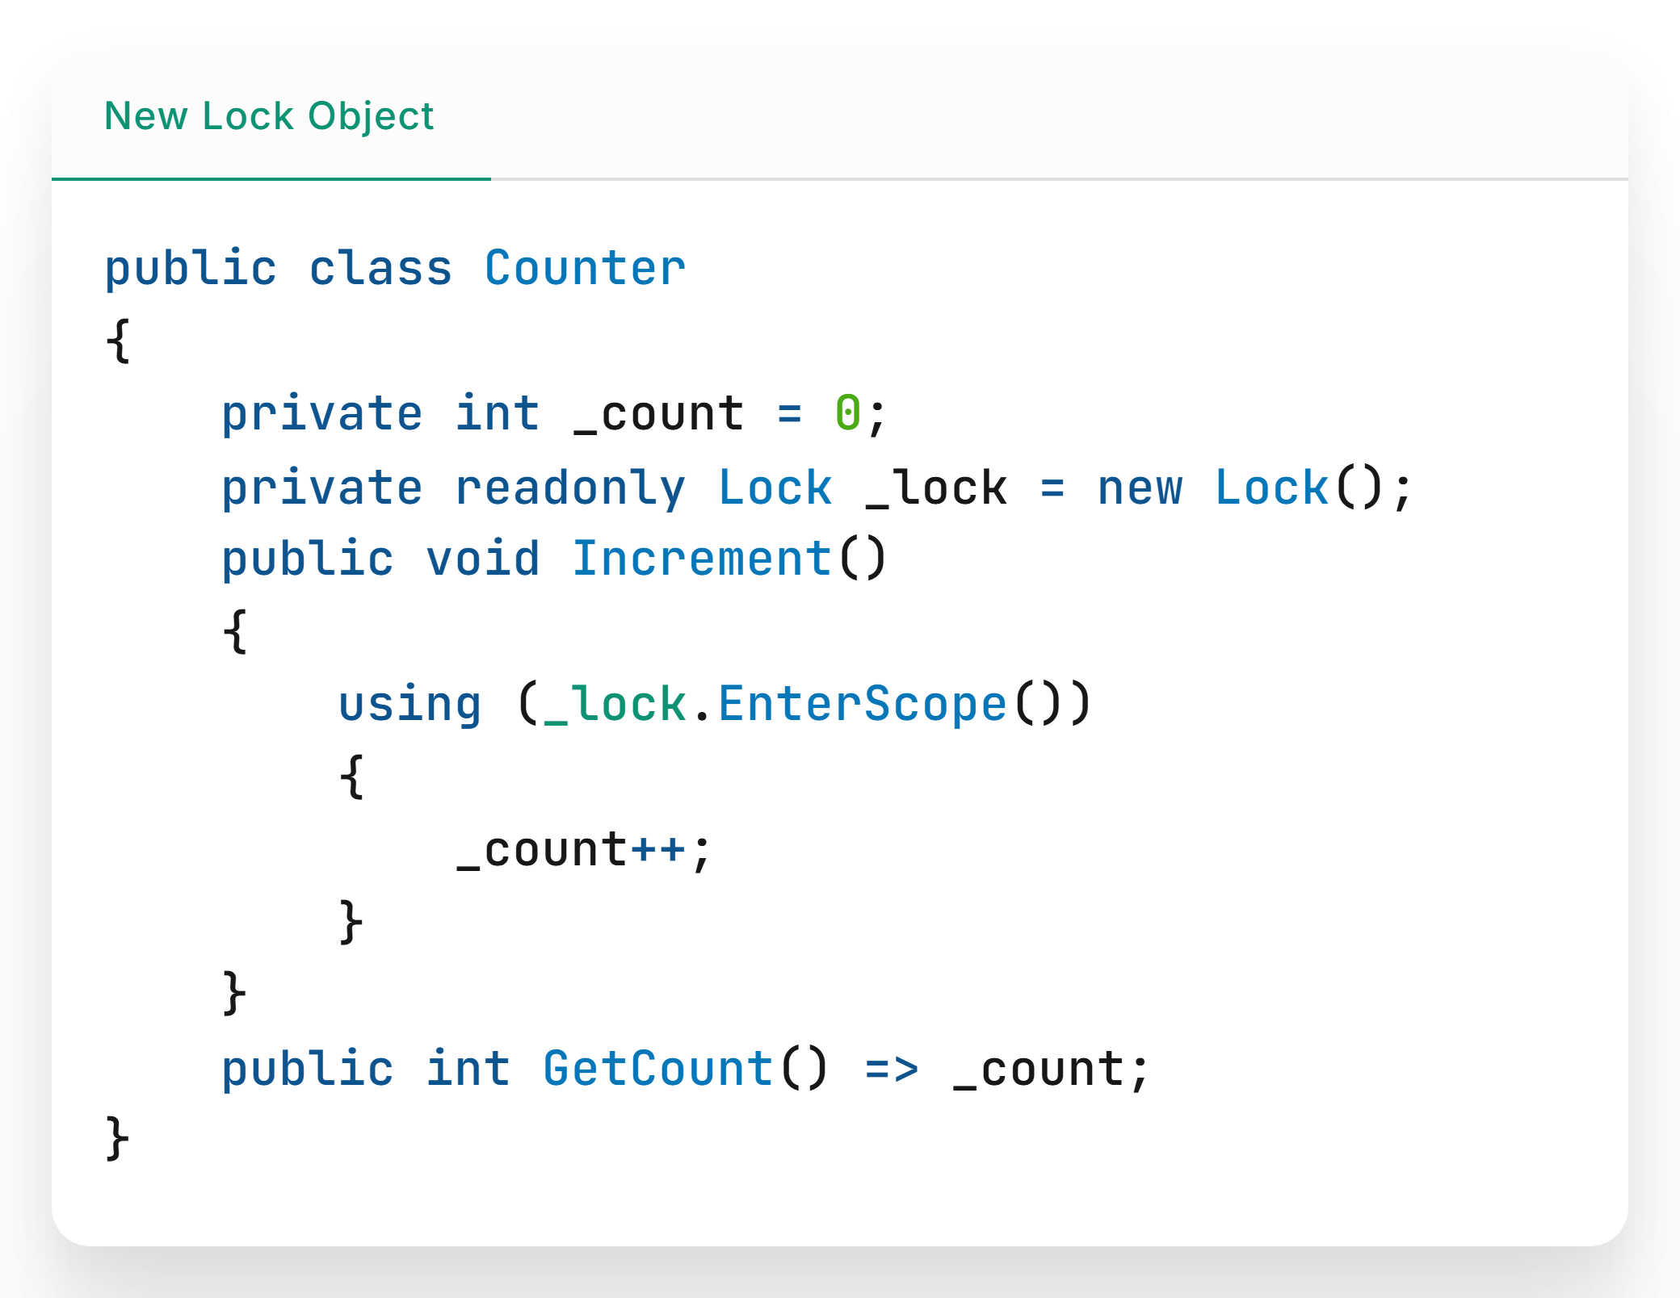

Slide 15
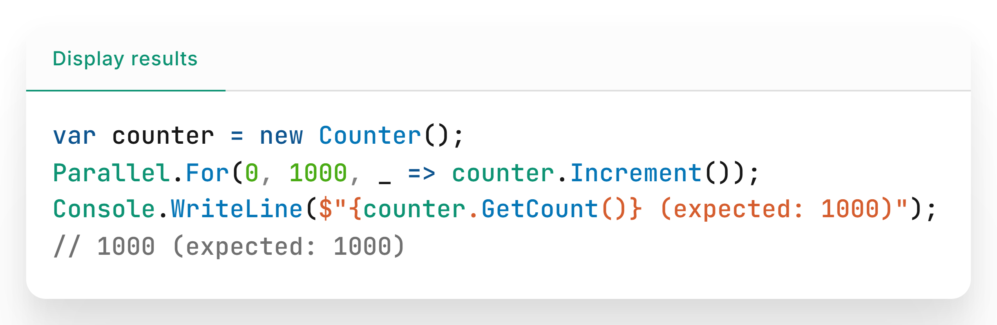

Slide 16
Partial properties
Partial properties split class implementation across files, making code modular and easier to manage.

Slide 17
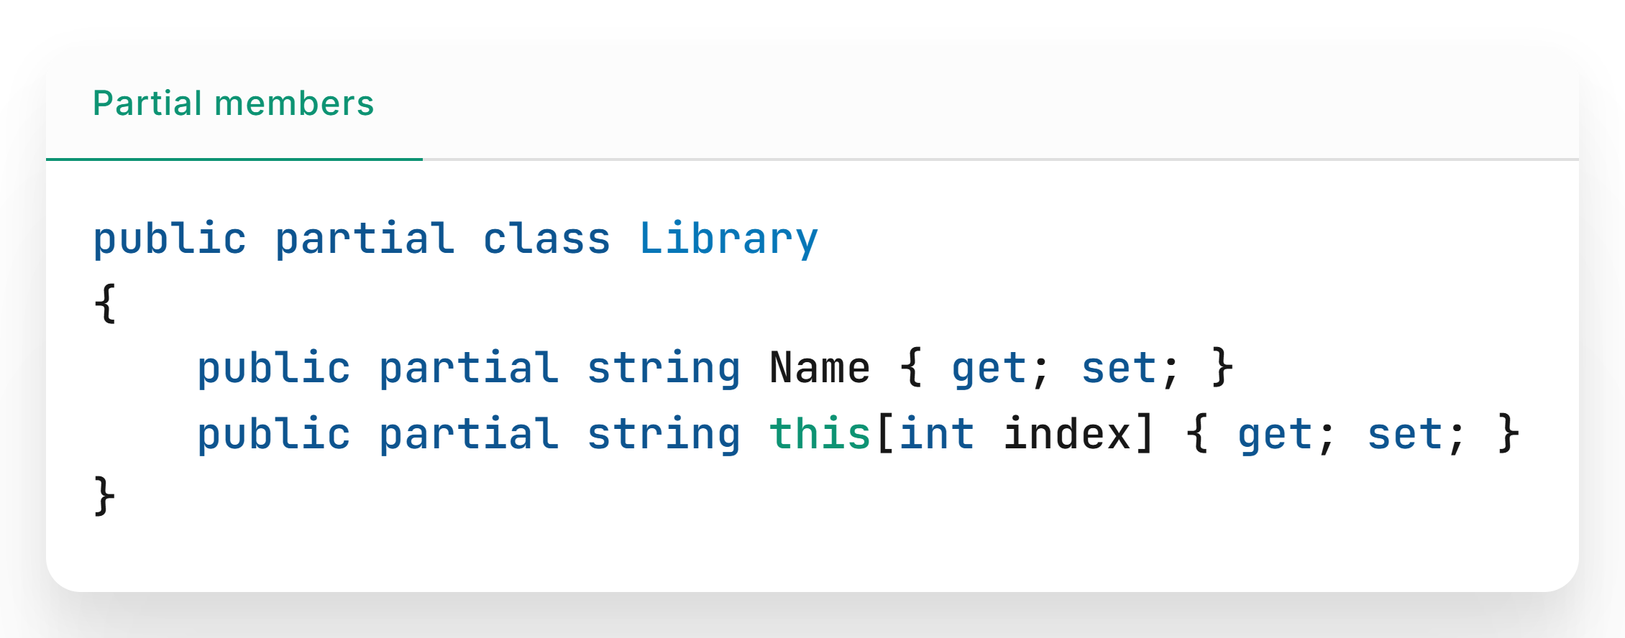

Slide 18
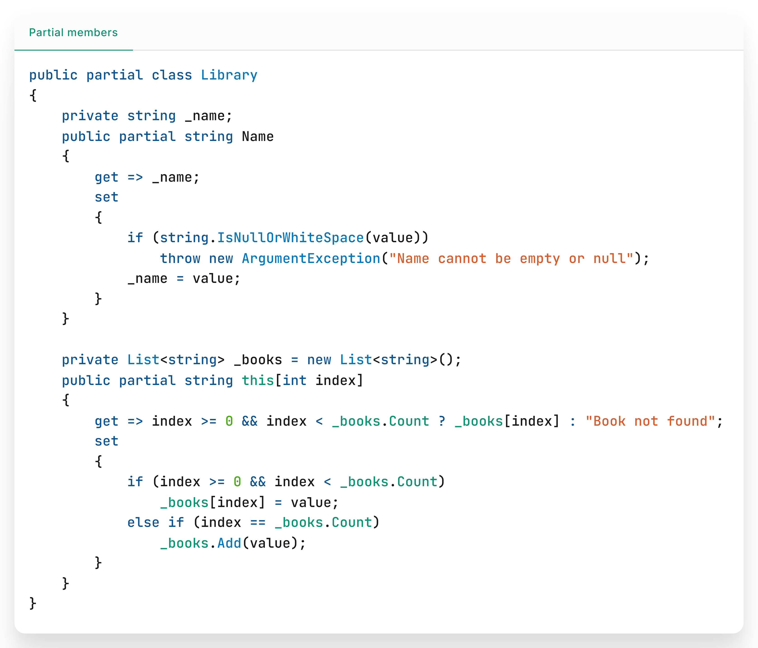

Slide 19
Overload resolution priority
OverloadResolutionPriority attribute helps the compiler choose which method to use when there are multiple with the same name and similar parameters

Slide 20
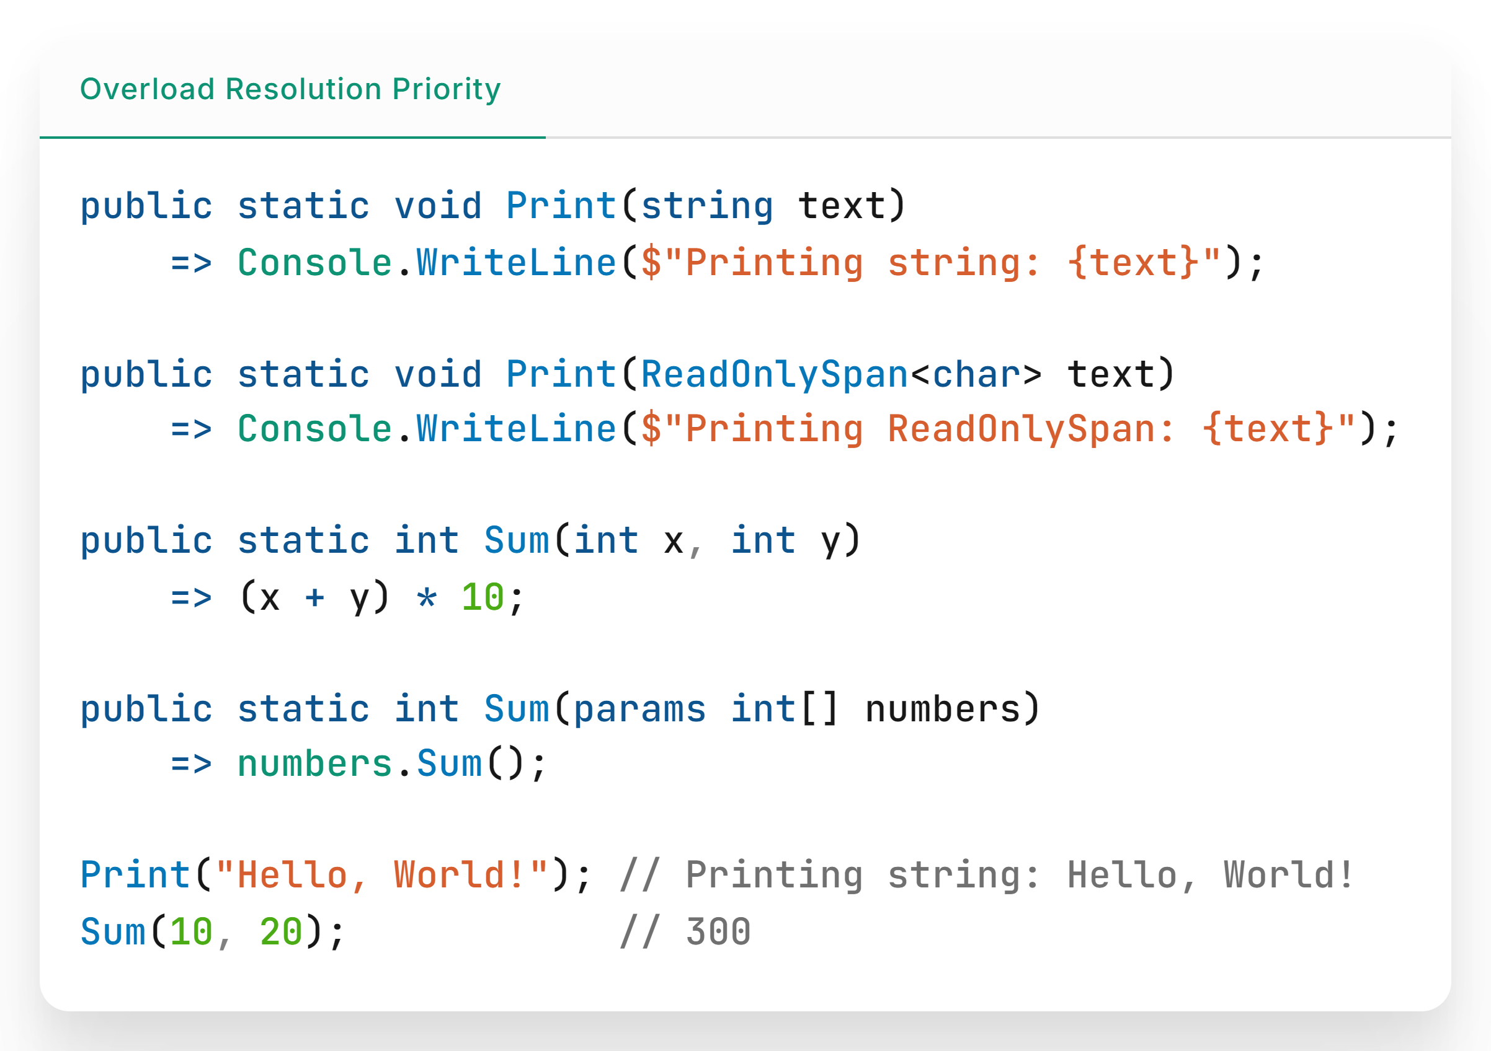

Slide 21
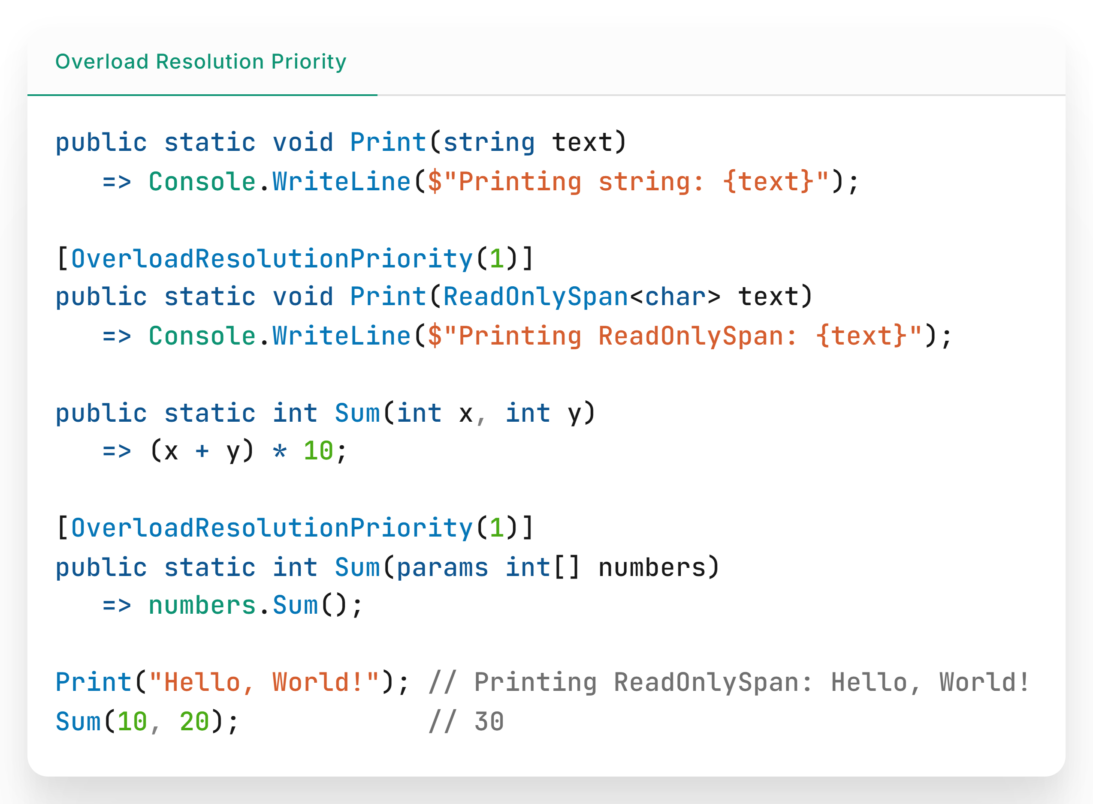

Slide 22


Demo repository

Slide 23
Get .NET 9
Download .NET 9 aka.ms/get-dotnet-9

Slide 24
Thank you

